Slide 1
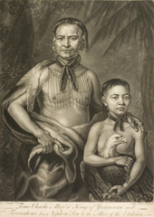
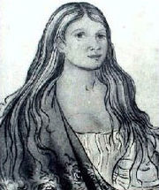
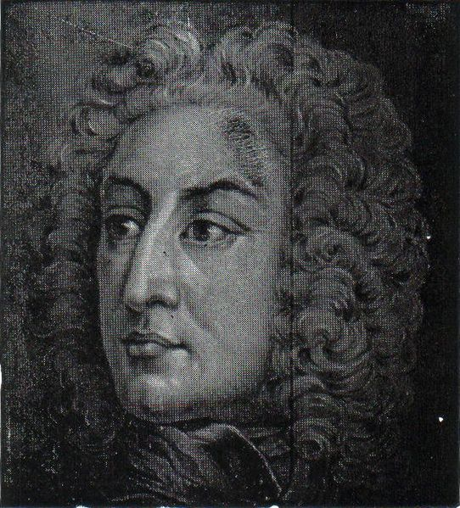
3 Important People Colonization of Georgia 5’w Assignment
`
This Photo by Unknown Author is licensed under CC BY-SA
This Photo by Unknown Author is licensed under CC BY-SA
This Photo by Unknown Author is licensed under CC BY-SA

Slide 2
Assignment
Today, your assignment is to create one of the following
Magazine
Foldable
Power Point
Political Cartoon
Bumper stickers
Diary
Poster
You will read about the 3 important people and then describe the 5 W’s Who?- Who is the person?
What? What did they do?
When? When did they live?
WHY? WHY ARE THEY IMPORTANT!
Include one picture per person and ONE Slide/page About Savannah

Slide 3
James Oglethorpe
James Oglethorpe-LEADER
James Edward Oglethorpe (1696-1785) is often given credit as the “founder” and “first governor” of Georgia. He is portrayed as a man who was so upset about the treatment of Britain’s debtors (poor people) that he established a colony for the “worthy poor;” helping those released from debtors’ prison start a new life in Georgia. While this myth is historically inaccurate, (FALSE) it should be understood that Oglethorpe did play an important role in the establishment of Georgia and served as its unofficial leader during the colony’s early years.
Oglethorpe lobbied to create a new colony and eventually he, along with 20 other Trustees, was granted a charter to establish Georgia. Today, Oglethorpe gets more credit in the creation of Georgia because he was the only trustee to travel to the new colony. Oglethorpe took on the roles of both military and civilian leader of the colony, and in many cases acted against the policies of the trustees.
During his time in Georgia, Oglethorpe befriended Native Americans, Tomochichi, a Native American Chief and Mary Musgrove, a translator, allowed groups of Jewish, Scottish, and German immigrants to settle in the colony, created the towns of Savannah and Fredericka, and fought the Spanish on three separate occasions. Oglethorpe left Georgia in 1743, never to return. Nonetheless, Oglethorpe was alive to witness the colony he “created” break away from England and become part of the United States of America.

Slide 4
Tomochichi
Tomochichi-CHIEF AND ALLY
Tomochichi was the chief of a tribe called the Yamacraw Indians. Tomochichi created this tribe in 1728 with members of the Creek and Yamasee Indians. Tomochichi’s group of around 200 believed that their best opportunities would come from an alliance with the English instead of the Spanish.
Tomochichi allowed Oglethorpe to settle on “Yamacraw Bluff” (the future home of Savannah) in hopes that the English would serve as allies and trading partners. Oglethorpe and Tomochichi developed a strong and long lasting friendship. Through the help of Mary Musgrove, who served as a translator, Tomochichi advised Oglethorpe on matters of Indian affairs and relations with the Spanish. He traveled with Oglethorpe to England and helped establish English speaking schools for Native Americans in Georgia. When Tomochichi died in 1739, he was said to be in his 90’s. Based on his achievements and service to the colony he was buried in Savannah with full English military honors.

Slide 5
Mary Musgrove
Mary Musgrove-TRANSLATOR
Mary Musgrove was born to a Creek Indian mother and English father. Due to this fact, Musgrove spoke both languages and understood the norms of both cultures. In 1717, Mary married fur trader John Musgrove, and they set up a trading post near the Savannah River. Mary’s fluency in both Creek and English served her well in her role as a trader and business woman. Musgrove became involved in the affairs of the colony of Georgia after her husband accompanied Oglethorpe on a trip to England. After this voyage, the trustees gave John land near Yamacraw Bluff. The Musgroves moved their trading post to this area and Mary continued to manage the successful business after John died in 1735. In addition to her business, Musgrove served as Oglethorpe’s personal interpreter from 1733-1743. She went on to become important in Georgia’s colonial society.

Slide 6
Yamacraw Bluff-Savannah
Savannah Savannah’s Squares
The city of Savannah is Georgia’s first city and former capital. Savannah was founded 16 miles inland from the Atlantic Ocean on what was called Yamacraw Bluff. The city is unique due to the fact that it is one of North America’s first “planned towns,” though no one is quite sure who influenced its plan. A popular story is that it was inspired by architect Robert Castell, Oglethorpe’s friend who died in debtor’s prison. Savannah was Georgia’s capital until 1786 and has played an important social, economic, and political role in the state’s history from its creation in 1733.
You may also look up Savannah in NewGeorgiaEncyclopedia.com for more information

